Slide 1
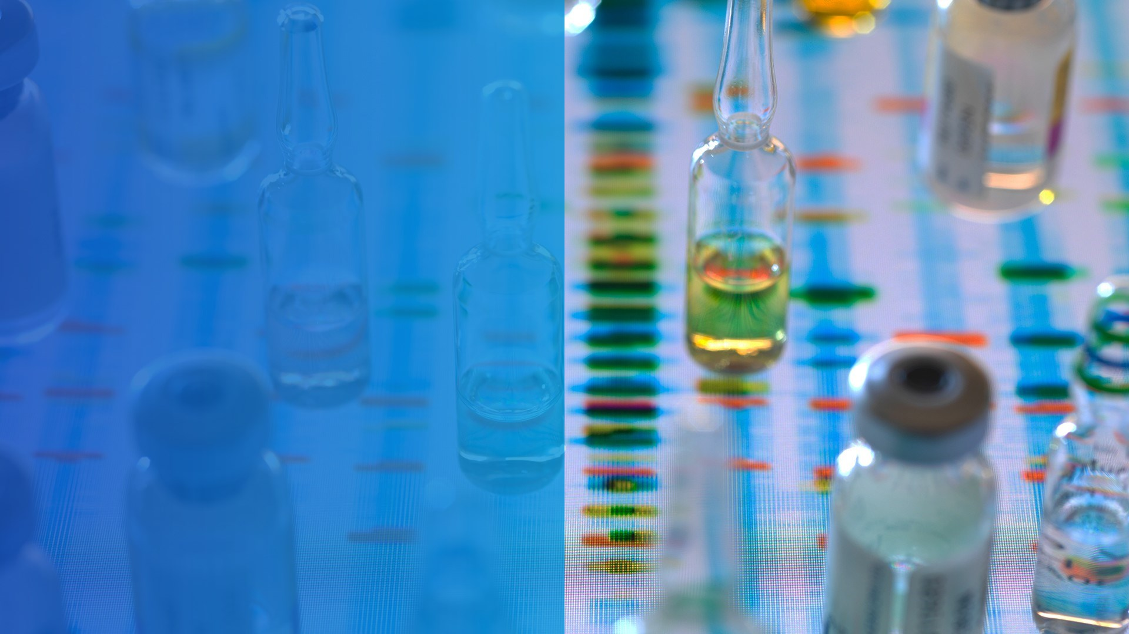

Pearls on Claims and Underwriting Liver Disease A Prequel to Cocktails and Covid 19 Pounds: Ingredients for Early Cirrhosis in Women
Elyssa Del Valle, M.D.

Slide 2


AGENDA
Epidemiology Of Our Top Liver Conditions
Liver Biopsy: Historical Review
Noninvasive liver testing
Underwriting Risks for Hep B, Hep C, ALD and MASLD using Noninvasive Testing
Case studies

Slide 3

Top Liver Conditions in Developed Countries
Chronic viral hepatitis (B and C) – increase in Hep C related to IV heroin on rise
Alcoholic liver disease
Hemochromatosis (iron overload)
Nonalcoholic fatty liver disease (NAFLD) or Metabolic-associated steatotic liver disease (MASLD)
Less common causes:
Autoimmune hepatitis, Primary and secondary biliary cirrhosis, Primary Sclerosing Cholangitis, Wilson, Alpha 1 antitrypsin deficiency, Celiac, Granulomatous liver disease, Polycystic liver diseases, Infection (brucellosis, syphilis, echinococcosis), Right heart failure, Osler Weber, veno-occlusive disease
Elyssa Del Valle, M.D.
Notes:
Per April 2017 ILC the largest event for EASL: Hep C is most widespread transmissible disease globally estimated to infect 185 million people of whom 350,000 die each yr.

Slide 4
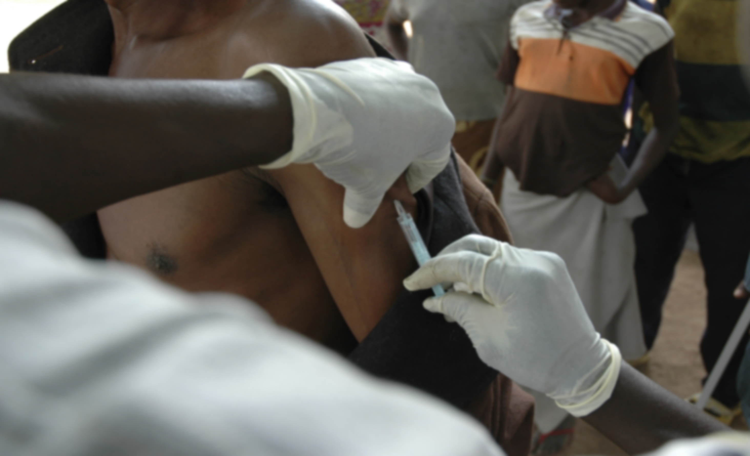
Top Liver Conditions in Developing Countries
Highest burden is Hepatitis B via vertical transmission Mother to Child
Hepatitis E especially in Africa and Asia from contaminated waters
Concomitant HIV with or without Hep B or C
Alcoholism
Aflatoxin (carcinogen) especially in sub-Saharan Africa and China
Liver cancer is most common cause of cancer in men in 11 developing countries: Mongolia, Gambia, Thailand, South Korea, Taiwan, North Korea, Guinea, Mali, Cameroon, Tonga and Guinea-Bissau (in order of most to least)
Liver flukes-Clonorchiasis – high association with cholangiocarcinoma
Elyssa Del Valle, M.D.
Notes:
Screening and passive immunization with hep B Immunoglobulin not affordable
Death rate is high with hep E in pregnancy especially genotype I during third trimester
Alflatoxin is a toxin produced by mold growing on rice or corn stored improperly.
Parasites and liver flukes are also problems in developing countries, causing a significant degree of liver disease by obstructing the hepatic and common bile ducts. The Chinese Liver fluke, referred to as Clonorchiasis, passes through fecal matter which are then ingested by mullusks. Humans can be infected when ingesting raw or undercooked fresh water fish. This type of fluke is associated with an extremely high risk for cholangiocarcinoma, a bile duct cancer.
Schistosomiasis, freshwater parasitic worms carried by infected snails and get into water, can go through skin and travel through bloodstream to liver, intestines
11 countries in order of most liver cancer to least is Mongolia, Gambia, Thailand, South Korea, Taiwan, North Korea, Guinea, Mali, Cameroon, Tonga and Guinea-Bissau

Slide 5
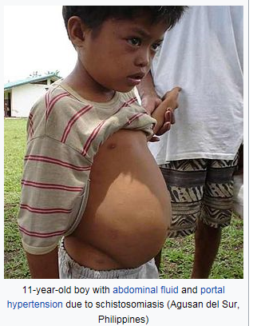
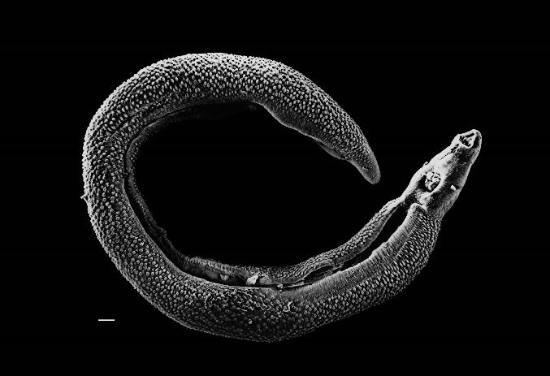
Schistosomiasis: Common Cause of Liver Disease Snail Fever
Ascites
Parasitic flatworm: Schistosome
5
Notes:
Schistosomiasis, freshwater parasitic worms carried by infected snails and get into water, can go through skin and travel through bloodstream to liver, intestines

Slide 6
Prevalence of Hepatitis B
Estimated 350 million worldwide have Chronic Hep B
2 Billion are infected at some point in their life – only 10% of infected persons are diagnosed
Most prevalent in Western Pacific and Africa in which 6% of population infected; South-East Asia, China, Taiwan, Sub-Saharan Africa and the Amazon basin with prevalence up to 60%; Rates falling with increased Hep B vaccination
Those at risk for chronic disease: depends mostly on age at which infected
In infants and children: 80-90% of infants infected during the first year of life
30-50% of children infected before age 6
In adults:
Less than 5% of otherwise healthy persons infected
Concern is 20-30% of adults with chronic Hep B will develop cirrhosis and/or liver cancer
Data from EASL Paris 2018 Liver Congress
6
Notes:
Infected child transmits to uninfected child during the first 5-6 yrs of life.

Slide 7
Hepatitis B Serology
Hepatitis B Surface Antigen
HBsAg
Hepatitis B Surface Antibody
anti-HBs
Hepatitis B core antibody
anti-HBc
Hepatitis Be antigen and antibody
E Ag is a Precore protein and means that the virus is actively replicating… highly infectious
Precore mutant will have negative E Ag and more ominous course
Associated with high viral titer
Seroconversion from HBeAg to anti-Hbe means a decrease in viral load and some remission of liver disease
The marker for the Hep B infection
Appears within 10 weeks of exposure
If recover, this becomes negative usually in 4-6 months
The antibodies appear as B antigen disappears
Will provide long term immunity
If given vaccine, this should be present if the vaccine was effective
Hep B core antigen is an intracellular antigen that cannot be measured in serum. The antibody can be detected in serum
Only present if exposed to the actual whole virion… so this is always negative for those with immunity from Hep B vaccine
In 5-30% of cases, you will have coexistence of HBsAg and Anti-HBs – indicates that the antibodies are unable to neutralize the circulating virions… thus these individuals are regarded as carriers of Hep B

Slide 8
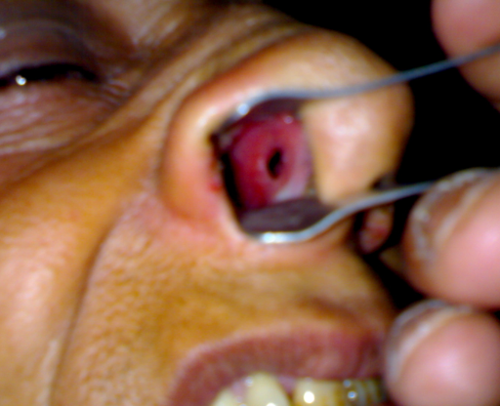
HCV most widespread transmissible disease globally, with 1 mill new infections per year of which 50 million have Chronic Hep C (0.7% of world)
Prevalence of Hepatitis C
25% spontaneously clear the virus within 6-12 months
39% of recent IV drug users live with Hepatitis C
Egypt had highest prevalence with 15 % having chronic hep C - prevalence declined to 1% as that group infected from mass schistosomiasis treatment dies off and national treatment and prevention program initiatives
Baby boomers born 1945-1965 make up 75% of cases of Hep C per CDC in USA. With increase IV heroin and cocaine use, there is an increase prevalence and thus, screening per US Preventive Task Force as of March 2020 recommends ages 18-79
Why Baby Boomers?
1970-1980 highest rates of Hep C
Non A/non B Hep not isolated in blood products until 1992
Universal precautions were not implemented until 1990s
HCV the silent pandemic – individuals usually would not know they contracted this condition
Stats from EASL Amsterdam liver congress April 2017
8
Notes:
Egypt’s issue with Schistosomiasis led to a large controlled campaign from 1950 – 1980 using IV tartar emetic as a community wide treatment. Unfortunately caused a large reservoir of Hep C. Was not until mid 1980s that an oral med, Prazequantel replaced tartar. The peak impact has yet to be reached as testing for hep C did not start until 1990s and there is a 20 yr period of chronicity to see the sequelae of Hep C.

Slide 9
Hepatitis C Serology
anti-HCV antibody
or HepCAb
HCV RNA
Reactive anti HCV
and negative RNA test
Several Genotypes of HCV
If antibody test is nonreactive, then chronic HCV infection is unlikely and testing can stop
those immunocompromised may have false-negative antibody
Absence of detectable HCV RNA essentially confirms the absence of chronic HCV infections
False negative RNA is unusual when sensitive quantitative and qualitative tests with low level of detection (eg, < 25 IU/ml) are used
+ anti HCV with negative RNA indications cleared infection
Because this is an RNA virus, there are different variants: 11 or so
Genotype 1 is most common in NA
Genotype 1 B is most serious with its risk for liver cancer
These differences have become moot since the Direct acting antivirals cure them all
Confirms HCV infection even with negative anti HCV antibody
Diagnosis of chronic hep C is made by reactive anti-HCV antibody with detectable HCV RNA.
Underwriting pearl: Assume chronic active with anti – HCV antibody on insurance if no available HCV RNA testing
Especially important in applicants ages 18-79

Slide 10
Fatty liver has doubled over last 20 yrs, and now, the leading cause of liver disease globally per the data conveyed at EASL Summit 2019 on NAFLD
Prevalence of MASLD
Metabolic dysfunction- associated Steatotic Liver Disease
Associated with obesity and DM and together are the key factors in why fatty liver is the #1 cause of liver disease in Western countries of Europe
Estimated from 2 large European studies that 43-70% with DM type 2 have MASLD (EASL Amsterdam Liver Congress 2017)
10-30% with MASLD have MASH (non-alcoholic steatohepatitis) or MASH
25% of those with MASH have cirrhosis
Schwimmer JB, Deutsch R, Kahen T, Lavine JE, Stanley C, Behling C. Prevalence of fatty liver in children and adolescents. Pediatrics. 2006;118:1388–1393. [PubMed]
Trust for America’s Health; Robert Wood Johnson Foundation. (2016). Adult obesity in the United States. Retrieved from http://stateofobesity.org/adult-obesity
Strobel, S et al NAFLD Summit 2019 Seville, Spain
10
Notes:
Nafld leads to nash in which liver becomes inflamed due to accumulation of fat

Slide 11
Most prevalent cause of advanced liver disease in Europe – mean alcohol consumption globally is 6.2 liters per person per year - Europe consumption is 10.9 liters
Prevalence of
Alcoholic Liver Disease (ALD)
Estimated 10-35% of alcoholics have ALD
Common for those with ALD to share other risk factors such as MASLD or chronic viral hepatitis
Stats per the Journal of Hepatology 2018 on Management of Alcohol related Liver disease by the European association of study of liver
EASL 2018
11

Slide 12

What Increases Risk of ALD?
>60 gm/day for > 10 yrs in men and >20 gms/day in women. Yet only 6-41% develop cirrhosis.
Drinking outside of mealtimes increases risk of ALD by almost 3-fold per Dionysus multivariate study of 6500+ ages 12-65 in Northern Italy
Binge drinking: Defined as > 5 drinks in men and > 4 in women in 2-hour period
Protein calorie malnutrition – mortality directly proportional to degree of malnutrition with up to 80% mortality with severe malnutrition (< 50% of normal nutritional intake)
Stats from EASL conference 2018
12

Slide 13

Mortality due to
Liver Cirrhosis
Liver disease is currently 11th leading cause of death globally with 2 million deaths per year globally per EASL Summit 2019
same stats per the IHME, International Health Metrics and Evaluation on Global Burden of Death, Our World in Data
Elyssa Del Valle, M.D.
13
Notes:
Facts from the International Liver Congress 2016 that took place in Barcelona April 2016(EASL)

Slide 14
Pathophysiology of Cirrhosis: Two Primary Mechanisms at Same Time
Hepatocellular Damage
Cytokines – Epithelial growth factor– hepatocyte growth factor--Tumor necrosis factor
Hepatic Fibrosis
Regenerating Liver Cells
Activate Kupffer cells, thrombocytes, hepatic
stellate cells
Hepatocellular Hyperplasia and Angiogenesis
Differentiate to myofibroblasts and proliferate
Regenerating Nodules
Synthesis and accumulation of extracellular matrix
Venous drainage cannot accommodate the
additional blood volume and the regenerating nodules compress hepatic venules all causing portal vein pressure to increase
Fibrosis
14
Notes:
There are 2 primary ingredients:
Hepatic fibrosis
Regenerating liver cells
In response to injury and loss, growth regulators induce hepatocellular hyperplasia (producing regenerating nodules) and arterial growth (angiogenesis). Among the growth regulators are cytokines and hepatic growth factors (eg, epithelial growth factor, hepatocyte growth factor, transforming growth factor-α, tumor necrosis factor). Insulin, glucagon, and patterns of intrahepatic blood flow determine how and where nodules develop.
Overview of Cirrhosis
Angiogenesis produces new vessels within the fibrous sheath that surrounds nodules. These vessels connect the hepatic artery and portal vein to hepatic venules, restoring the intrahepatic circulatory pathways. Such interconnecting vessels provide relatively low-volume, high-pressure venous drainage that cannot accommodate as much blood volume as normal. As a result, portal vein pressure increases. Such distortions in blood flow contribute to portal hypertension, which increases because the regenerating nodules compress hepatic venules.
The progression rate from fibrosis to cirrhosis and the morphology of cirrhosis vary from person to person. Presumably, the reason for such variation is the extent of exposure to the injurious stimulus and the individual’s response.

Slide 15
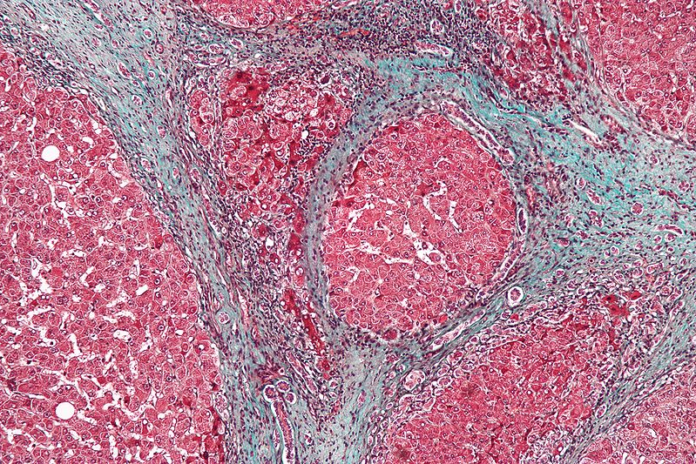
Histology of Liver Cirrhosis
15

Slide 16
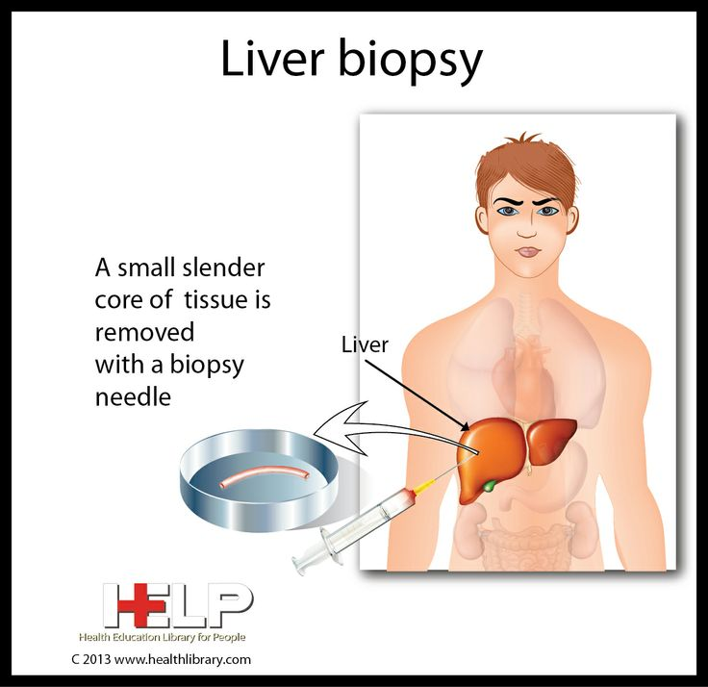
Gold Standard
First liver aspirate performed by German physician: Paul Ehrlich in 1883
Reportedly, first liver biopsy performed percutaneously in 1920s
16

Slide 17
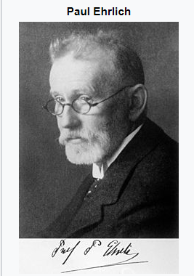
Let’s digress a bit: Paul Ehrlich, M.D
Awarded Nobel Prize in Physiology and Medicine 1908 for work on Immunity
Termed “MAST cell” from the German word Mast, a fattening feed for cattle
With stains, he could differentiate lymphocytes and leukocytes. Created basis to systematize leukemias.
Studied RBCs and able to subdivide into normoblasts, megaloblasts, poikiloblasts laying down the basis for anemias.
Discovered first drug to target syphilis: Salvarsan
Methylene Blue and Malaria
Coined term: Magic Bullet…..targeting pathogens that cause disease or cancer without harming healthy tissue
Elyssa Del Valle, M.D.
17
Notes:
Mast Cell german name for a fattening feed in cattle. Granules in protoplasm thought to be sign of good nourishment
Plasmodium parasite

Slide 18
Expensive: if not insured, cost range €358 to €1,160 for an outpatient procedure
Pneumothorax – collapse lung requiring chest tube
Associated with pain (20%) and bleeding (1%)
Liver Biopsy Cons and Complications
Death reported 1/10,000 biopsies
Interpreted by different pathologists can result in discrepancies in staging
Only small piece of liver (1/50,000th)– can lead to sampling error and incorrect staging: under-staging in up to 25-30% of liver biopsies
Elyssa Del Valle, M.D.
18
Notes:
Invasive, poor reproducibility that may be explained by heterogeneity of liver fibrosis, small size of hepatic samples and inter and intra observer variability in the histological exam
Glisson’s capsule named for British doc Francis Glisson

Slide 19
The indications for biopsy must be weighed against the risk of complications
Key Points On
Liver Biopsy
Liver biopsy - means of securing the initial diagnosis of autoimmune diseases including AIH, PSC, mixed forms of both AIH and PSC (overlapping syndrome) and PBC
Among all diagnostic methods for hepatic nodules, liver biopsy has the greatest sensitivity and specificity with respect to determination of malignancy
Liver bx not necessary if clinical, labs and radiologic data strongly suggest the presence of cirrhosis or results do not alter the patient’s management
19

Slide 20
Classification of Liver Histology
Grade – Inflammation
Stage - Fibrosis
20

Slide 21
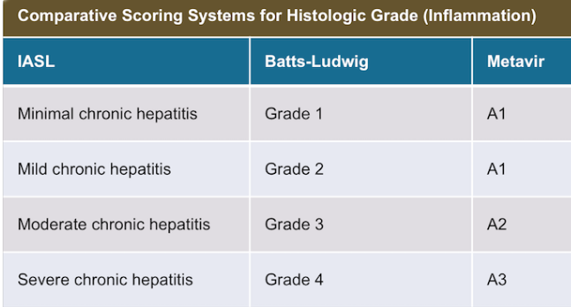
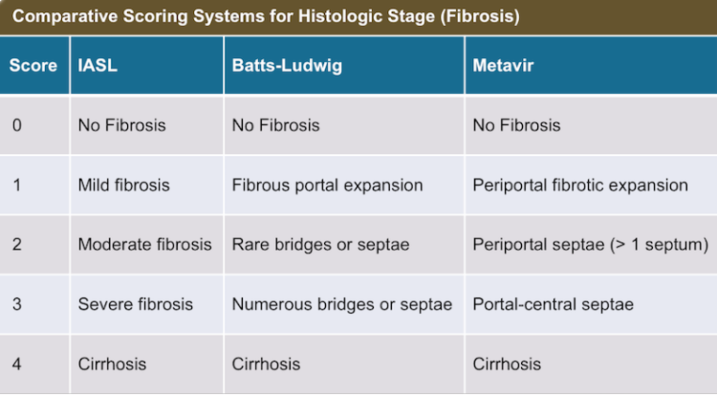
Liver Biopsy Grading and Staging
21

Slide 22

How to Suspect Liver Cirrhosis w/o Biopsy
Stigmata of chronic liver disease: physical exam findings
Evidence of cirrhosis on lab or radiologic testing or by direct visualization while undergoing surgical procedure
Evidence of decompensated cirrhosis: esophageal varices, ascites, spontaneous bacterial peritonitis or hepatic encephalopathy
Elyssa Del Valle, M.D.
22

Slide 23
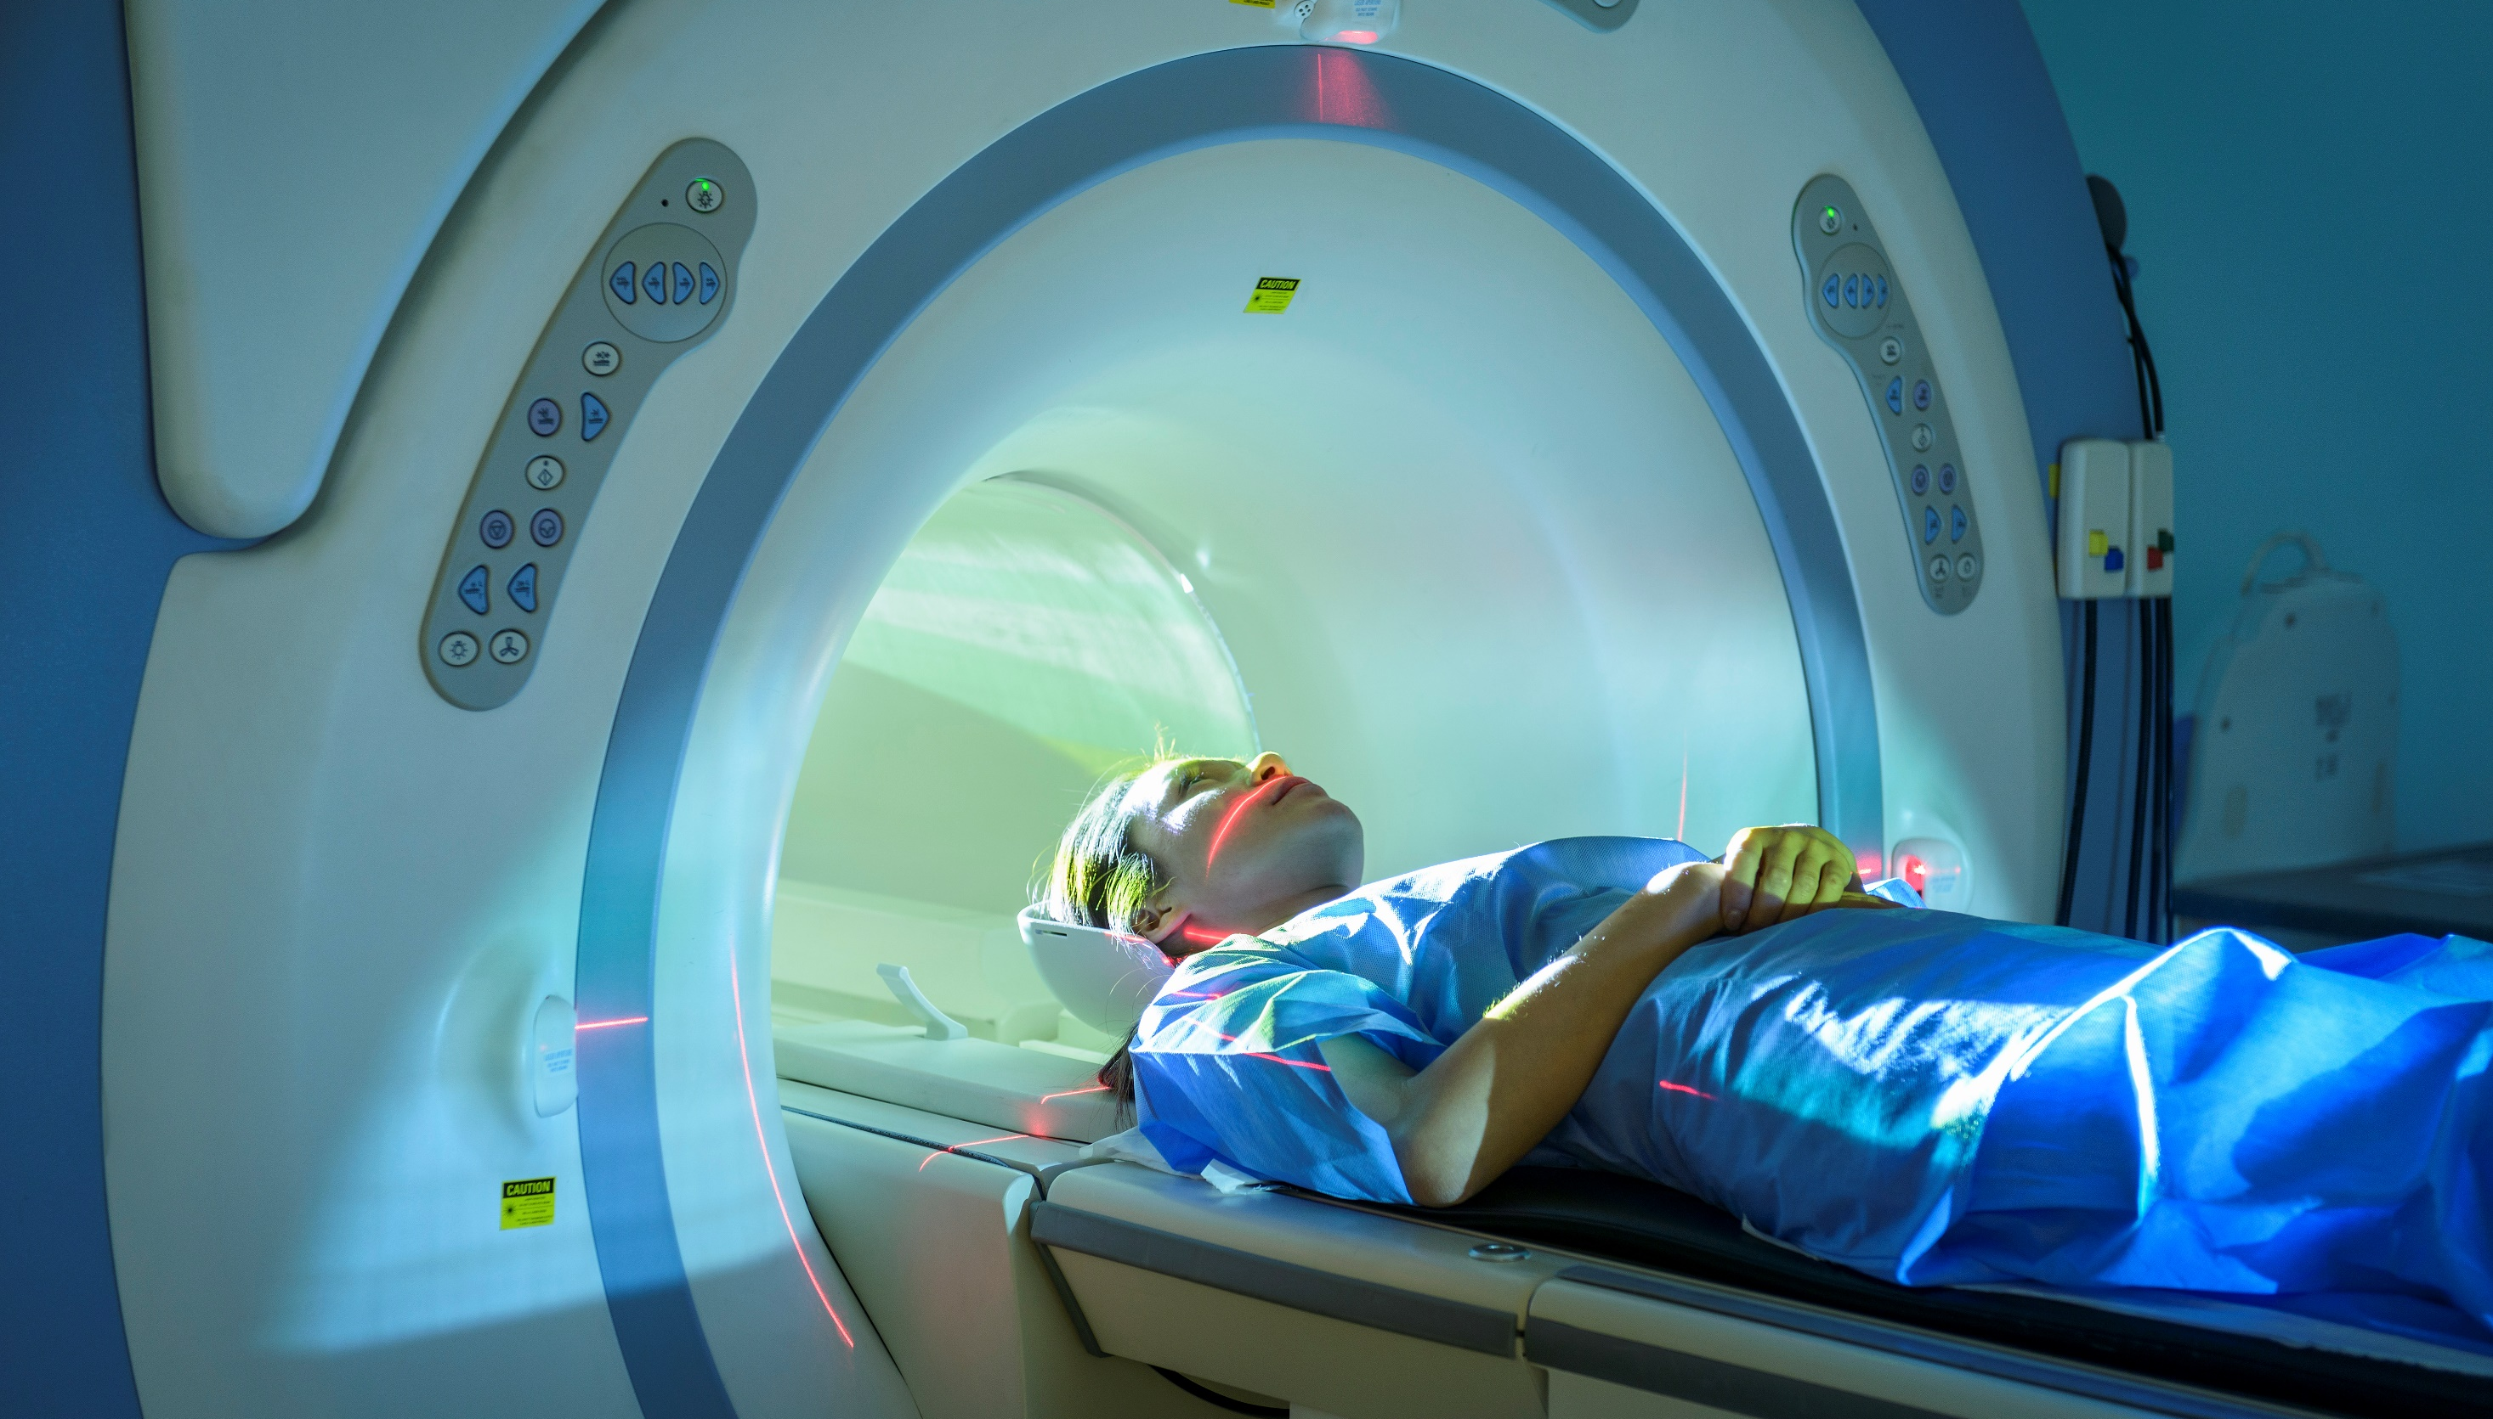

Liver Cirrhosis: Complications
Hepatic encephalopathy
Hepatorenal syndrome
Ascites
Spontaneous bacterial peritonitis
Variceal hemorrhage
Hepatocellular carcinoma
Hepatopulmonary syndrome
No way to reverse these late stages of Cirrhosis Decompensation
Only treatment at late stage is Liver Transplantation
23

Slide 24
Red Flags that suggest liver failure
Lab Tests: The Real Liver Function Tests
Low Platelets
Low Albumin
Elevated INR or Protime
Fibrosure/FibroTest scores 0-1 give degree of fibrosis
Fib-4 (to be discussed in closing session)
Imaging suggesting Liver Disease
Abdominal Ultrasound with increased echogenicity suggests steatosis
CT with hypoattenuation suggests steatosis
FibroScan gives degree of fibrosis stage and CAP (controlled attenuation parameter) gives degree of steatosis

Slide 25
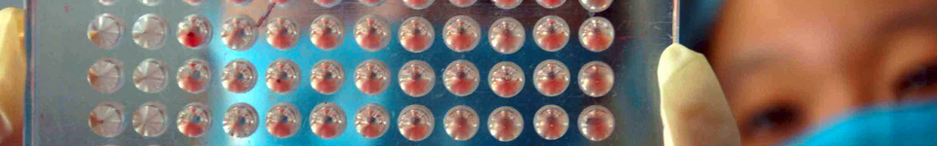
FibroTest FibroSure marketed in Europe marketed in USA
Non invasive method developed by Australian investigators
Validated Predictor of Liver Fibrosis using 3 ccs of fasting blood
Score from 0-1
Based on age, gender and these 6 serum analytes:
Serum bilirubin
ALT
GGT
Alpha 2 macroglobulin
Alpha 2 globulin (haptoglobin)
Apolipoprotein A1
FibroTest has been recommended the first line assessment for fibrosis with untreated Chronic Hepatitis C in 2006 by the French National Authority for Health
25

Slide 26
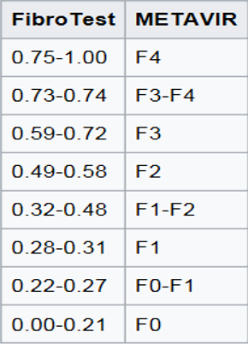
FibroTest/FibroSure Reference Interval
Fibrosis stage
F0 (no fibrosis) 0.00 – 0.21
F0-F1 : 0.22 – 0.27
F1 ( portal fibrosis) 0.28-0.31
F1-F2 : 0.32-0.48
F2 (bridging fibrosis w/ few septa) 0.49-0.58
F3 (bridging fibrosis w/ many septa) 0.59-0.72
F3-F4 : 0.73-0.74
F4 (cirrhosis) 0.75-1.00
VALID NO MATTER THE ETIOLOGY OF LIVER DZ
26
Notes:
Quest sends to LabCorp

Slide 27
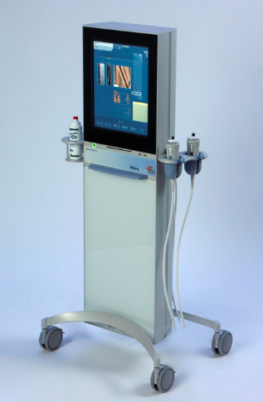
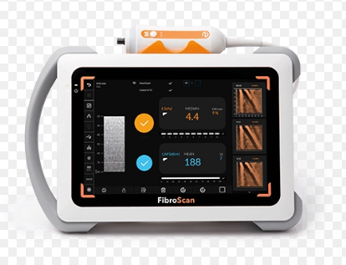
FibroScan
27

Slide 28
FibroScan
Historical background: Palpating for liver firmness since 1500 BC and has been the usual practice since 1930
FibroScan introduced in Europe in 2003
Approved in April 2013 by the FDA in US
Painless rapid test (15 minutes)
Shear waves measure the elasticity of the liver using technique called Vibration controlled Transient Elastography (VCTE)
Units are called kPa (kilopascals) – higher the number, greater the stage of fibrosis – score range 2.5-75 kPa
Caution: the degree of stiffness varies according to type of liver disease. For example, cut off for cirrhosis is lower in Hepatitis B and C and higher for ALD and cut off even lower in NAFLD
28

Slide 29
FibroScan Use in Hepatitis C
Stiffness | Indicates | Advice
> 12.9 kPa | Cirrhosis NPV = 95% | US and AFP every 6 months for surveillance of Liver Cancer. Strongly consider HCV therapy
> 9.6 kPa | Advanced Fibrosis > F2 | Strongly consider HCV therapy
< 7.1 kPa | Lower level of fibrosis < F2 NPV> 90% | Consider HCV therapy vs. Observation
29

Slide 30
FibroScan Use in Hepatitis B
Stiffness | Indicates | Advice
> 12.9 kPa | Cirrhosis | US and AFP every 6 months for surveillance of Liver cancer. Strongly consider HBV therapy
> 7.3 kPa | > F2 PPV = 94% | Strongly consider HBV therapy
5.2-7.2 kPa | Lower level of fibrosis | Observation if low HBV viremia. Repeat FibroScan in 1 year
< 5.3 kPa | < F2 NPV=83% | Observation if low HBV viremia
30

Slide 31
FibroScan Use in Metabolic associated steatotic liver disease (MASLD)
Stiffness | Indicates | Advice
> 10.2 kPa | Cirrhosis PPV = 99% | Refer to Hepatology. US and AFP every 6 months for surveillance of liver cancer
> 7.9 kPa | > F3 PPV=97% | Refer to Hepatology, may need therapy (Vitamin E) or enter clinical trial
6 – 7.8 kPa | F2 | May observe in Primary Care. Repeat FibroScan in 1 year
<6 kPa | Lower level of fibrosis | Observe in Primary Care. Diet and exercise. DM and HLD control
31

Slide 32
FibroScan Use in Alcoholic Liver Disease (ALD)
Stiffness | Indicates | Advice
> 18.7 kPa | Cirrhosis PPV = 90% | US and AFP every 6 months for surveillance of Liver cancer. Stop all alcohol
12.7-18.7 kPa | > F3 Advanced fibrosis PPV=92% | Stop all alcohol. Consider US and AFP every 12 months for surveillance of Liver cancer
> 8.2-12.6 | > F2 Advanced fibrosis PPV = 100% | Stop all alcohol
32

Slide 33
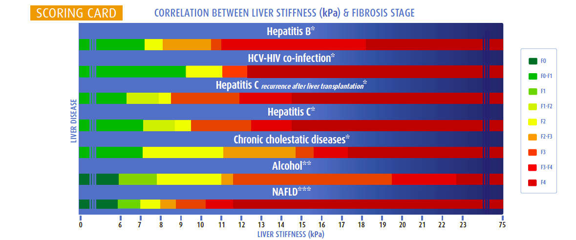
Fibrosis Scoring Card
33

Slide 34

Pop Question
Which testing result is most compatible with cirrhosis in a patient with Chronic Active Hepatitis B?
kPa of 7.2
FibroTest result of 0.52
FibroSure result of 0.80
34
Notes:
Answer is C

Slide 35

Pop Question
Which condition is most likely associated with Cirrhosis with a kPa of 10.5?
Alcoholic liver
MASLD
Hepatitis B
Hepatitis C
35
Notes:
Answer is B NAFLD

Slide 36
Cases

Slide 37
45-year-old IT specialist in NL for last 10 yrs from Vietnam. Has hx of hepatitis B. Hx GERD and diet-controlled Diabetes. Recent evaluation by hepatologist. Paramed: BP 145/85, Height 5’9” Wt 200 (91 kg) Insurance labs: LFTs: AST 145 U/L (3.5 x normal), ALT 155 U/L (3 x normal), Albumin 32 g/L, Glucose 6.5 mmol/L , Hemoglobin A1C 7.2%. Hepatitis C Antibody neg; Hepatitis B Ag reactive APS from GI/Hepatology: Exam: mildly obese, palmar erythema, few facial spider nevi, abdominal exam notes questionable fluid wave, slightly distended with no hepatosplenomegaly. Labs: Hepatitis Be Ag reactive. Hepatitis B viral load 18,131,576 IU/ML CBC: Platelets 130K nml otherwise; AFP 2.1, INR 2.0 FibroTest ordered. Test on next slide. MD initiated Viread for diagnosis of chronic active Hep B
Case 1
37

Slide 38
45-year-old IT specialist in NL for last 10 yrs from Vietnam. Has hx of hepatitis B. Hx GERD and diet-controlled Diabetes. Recent evaluation by hepatologist. Paramed: BP 145/85, Height 5’9” Wt 200 (91 kg) Insurance labs: LFTs: AST 145 U/L (3.5 x normal), ALT 155 U/L (3 x normal), Albumin 32 g/L, Glucose 6.5 mmol/L , Hemoglobin A1C 7.2%. Hepatitis C Antibody neg; Hepatitis B Ag reactive APS from GI/Hepatology: Exam: mildly obese, palmar erythema, few facial spider nevi, abdominal exam notes questionable fluid wave, slightly distended with no hepatosplenomegaly. Labs: Hepatitis Be Ag reactive. Hepatitis B viral load 18,131,576 IU/ML CBC: Platelets 130K nml otherwise; AFP 2.1, INR 2.0 FibroTest ordered. Test on next slide. MD initiated Viread for diagnosis of chronic active Hep B
Case 1
38

Slide 39
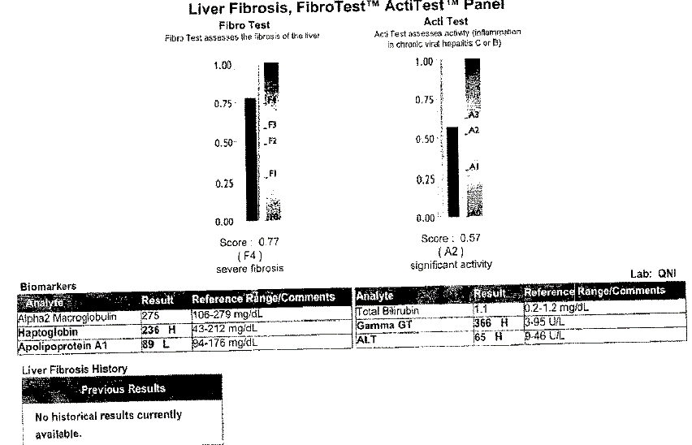
39

Slide 40

Chronic Active Hepatitis B from endemic region
Physical exam findings
Lab findings
No liver bx however FibroTest score
What Risk Assessment?
What
Concerns
You?
40

Slide 41

Case 2
Baby Boomer born USA 1957: Male with clean medical hx.
Agent asking for low substandard, maybe a T 2
Insurance Labs: AST 33, ALT 99
HepBS Ag nonreactive, HepCAb reactive
That is all you have. Does anyone see low substandard or STD?
41

Slide 42
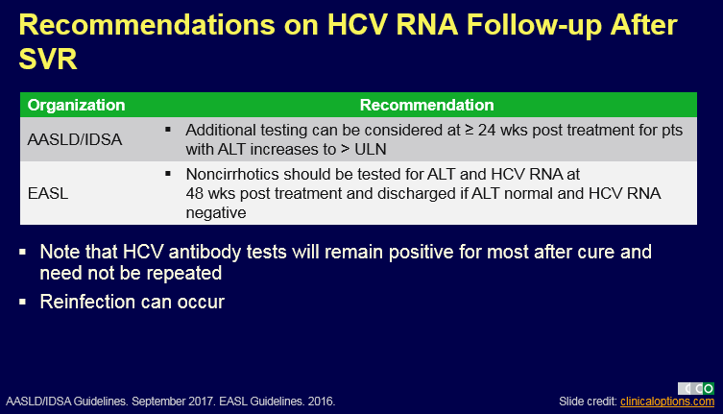
Agent asking how to improve rating?
1) Noninvasive liver testing
2) Treatment with Direct acting viral agents and then repeat noninvasive liver testing after Sustained Viral Response
Definition of Sustained Viral Response (SVR) is undetectable viral load at least 6 months after end of treatment … Considered a cure.
Thus, no need to Postpone for current liver ultrasound or AFP
42

Slide 43
Fibroscan Results Obtained
Fibroscan 8.5 kPa
Would the offer change?
Stiffness | Indicates | Advice
> 12.9 kPa | Cirrhosis NPV = 95% | US and AFP every 6 months for surveillance of Liver Cancer. Strongly consider HCV therapy
> 9.6 kPa | Advanced Fibrosis > F2 | Strongly consider HCV therapy
< 7.1 kPa | Lower level of fibrosis < F2 NPV> 90% | Consider HCV therapy vs. Observation
43

Slide 44
6 months after 12 weeks of sofosbuvir/ledipasvir and has a non detected HCV RNA
Applicant Gets on Harvoni sofosbuvir/ledipasvir with SVR
Repeat Fibroscan 6.0 kPa
What would you rate him now??
44

Slide 45

Any questions?
Elyssa Del Valle, M.D.

Slide 46

Topic before we drink and become merrier!!! Cocktails and Covid 19 Pounds: The Essential Ingredients for Early Cirrhosis in Women
Elyssa Del Valle, M.D. DBIM

Slide 47
Legal notice
©2025 Swiss Re. All rights reserved. You may use this presentation for private or internal purposes but note that any copyright or other proprietary notices must not be removed. You are not permitted to create any modifications or derivative works of this presentation, or to use it for commercial or other public purposes, without the prior written permission of Swiss Re.
The information and opinions contained in the presentation are provided as at the date of the presentation and may change. Although the information used was taken from reliable sources, Swiss Re does not accept any responsibility for its accuracy or comprehensiveness or its updating. All liability for the accuracy and completeness of the information or for any damage or loss resulting from its use is expressly excluded.

